Slide 1
MECHNICAL VENTILATION
DR MANISH SHARMA Additional Superintendent JK Lon Hospital
(PAEDIATRIC INTENSIVIST)
In Charge Accident/Emergency, JK Lon Hospital, Jaipur SMS MEDICAL COLLEGE , JAIPUR

Slide 2
Mechanical Ventilation is ventilation of the lungs by artificial means usually by a ventilator.
A ventilator delivers gas to the lungs with either negative or positive pressure.

Slide 3
Indications and Goals for Ventilation
Type I or hypoxemic respiratory failure
Type II or hypercapnic respiratory failure
Goals :
Correct hypoxemia – PO₂ 60mmHg, O₂ Saturation 90%
Correct hypercapnia – PCO₂ ~ 40mmHg
Reduce work of breathing and hence cardiac workload
Provide rest to respiratory muscles and reduce oxygen cost of breathing

Slide 5
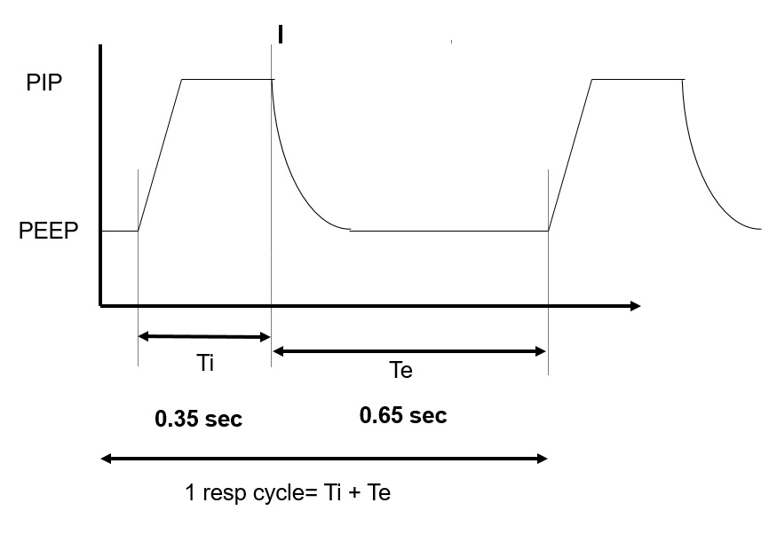
Basic terminologies – Respiratory cycle (Ti/Te/PIP/PEEP/Vt)

Slide 6
Criteria for institution of ventilatory support:
Normal range | Ventilation indicated | Parameters
15-20,20-25 6-8 65-75 75-100 | >10- 15 < 5 < 15 <-20 | A- Pulmonary function studies: Respiratory rate (breaths/min). Tidal volume (ml/kg body wt) Vital capacity (ml/kg body wt) Maximum Inspiratory Force (cm HO₂)

Slide 7
Criteria for institution of ventilatory support:
Normal range | Ventilation indicated | Parameters
7.35-7.45 75-100 35-45 >500 | < 7.25 <60 >50 <100 | B- Arterial blood Gases PH PaO₂ (mmHg) PaCO₂ (mmHg) PaO2/FiO2

Slide 8
Types of Mechanical ventilators:
Negative-pressure ventilators
Positive-pressure ventilators.

Slide 9
Positive-pressure ventilators
Positive-pressure ventilators deliver gas to the patient under positive-pressure, during the inspiratory phase.

Slide 10
Types of Positive-Pressure Ventilators
1- Volume Ventilators.
2- Pressure Ventilators
3- High-Frequency Ventilators

Slide 11
1- Volume Ventilators
The volume ventilator is commonly used in critical care settings.
The basic principle of this ventilator is that a designated volume of air is delivered with each breath.
The amount of pressure required to deliver the set volume depends on :-
- Patient’s lung compliance
- Patient–ventilator resistance factors.

Slide 12
Therefore, peak inspiratory pressure (PIP ) must be monitored in volume modes because it varies from breath to breath.
With this mode of ventilation, a respiratory rate, inspiratory time, and tidal volume are selected for the mechanical breaths.

Slide 13
2- Pressure Ventilators
The use of pressure ventilators is increasing in critical care units.
A typical pressure mode delivers a selected gas pressure to the patient early in inspiration, and sustains the pressure throughout the inspiratory phase.
By meeting the patient’s inspiratory flow demand throughout inspiration, patient effort is reduced and comfort increased.

Slide 14
Although pressure is consistent with these modes, volume is not.
Volume will change with changes in resistance or compliance,
Therefore, exhaled tidal volume is the variable to monitor closely.
With pressure modes, the pressure level to be delivered is selected, and with some mode options (i.e., pressure controlled [PC], described later), rate and inspiratory time are preset as well.

Slide 15
3- High-Frequency Ventilators
High-frequency ventilators use small tidal volumes (1 to 3 mL/kg) at frequencies greater than 100 breaths/minute.
The high-frequency ventilator accomplishes oxygenation by the diffusion of oxygen and carbon dioxide from high to low gradients of concentration.

Slide 16
This diffusion movement is increased if the kinetic energy of the gas molecules is increased.
A high-frequency ventilator would be used to achieve lower peak ventilator pressures, thereby lowering the risk of barotrauma.

Slide 17
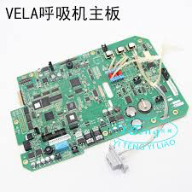
outcomes
Alarms reset
Mode
Inspiratory hold
Expiratory hold
100% FiO2
Accept Mode
Preset variables and alarms
Notes:
Touch screen – select mode - then variables like rate / pressure / volume/ FiO2 all displayed … go on selecting. Tthese are preset.

Slide 18
Ventilator mode
The way the machine ventilates the patient
How much the patient will participate in his own ventilatory pattern.
Each mode is different in determining how much work of breathing the patient has to do.

Slide 19
Modes of Mechanical Ventilation
A- Volume Modes
B- Pressure Modes

Slide 20
A- Volume Modes
1- Assist-control (A/C)
2- Synchronized intermittent
mandatory ventilation (SIMV)

Slide 21
1- Assist Control Mode A/C
The ventilator provides the patient with a pre-set tidal volume at a pre-set rate .
The patient may initiate a breath on his own, but the ventilator assists by delivering a specified tidal volume to the patient.
Patient can initiate breaths that are delivered at the preset tidal volume.
Client can breathe at a higher rate than the preset number of breaths/minute

Slide 22
Modes of ventilation- AC

Slide 23
The total respiratory rate is determined by the number of spontaneous inspiration initiated by the patient plus the number of breaths set on the ventilator.
In A/C mode, a mandatory (or “control”) rate is selected.
If the patient wishes to breathe faster, he or she can trigger the ventilator and receive a full-volume breath.

Slide 24
Often used as initial mode of ventilation
When the patient is too weak to perform the work of breathing (e.g., when emerging from anesthesia).
Disadvantages:
Hyperventilation,

Slide 25
2- Synchronized Intermittent Mandatory Ventilation (SIMV)
The ventilator provides the patient with a pre-set number of breaths/minute at a specified tidal volume and FiO₂.
In between the ventilator-delivered breaths, the patient is able to breathe spontaneously at his own tidal volume and rate with no assistance from the ventilator.
However, unlike the A/C mode, any breaths taken above the set rate are spontaneous breaths taken through the ventilator circuit.

Slide 26
Synchronized Intermittent Mandatory Ventilation (SIMV)

Slide 27
The tidal volume of these breaths can vary drastically from the tidal volume set on the ventilator, because the tidal volume is determined by the patient’s spontaneous effort.
Adding pressure support during spontaneous breaths can minimize the risk of increased work of breathing.
Ventilators breaths are synchronized with the patient spontaneous breathe.
( no fighting)

Slide 28
SIMV + PS Ventilation

Slide 29
B- Pressure Modes
1- Pressure-controlled ventilation (PCV)
2- Pressure-support ventilation (PSV)
3- Continuous positive airway pressure
(CPAP)
4- Positive end expiratory pressure (PEEP)
5- Noninvasive bilevel positive airway pressure ventilation (BiPAP)

Slide 30
Inverse ratio ventilation (IRV) mode reverses this ratio so that inspiratory time is equal to, or longer than, expiratory time (1:1 to 4:1).
Inverse I:E ratios are used in conjunction with pressure control to improve oxygenation by expanding stiff alveoli by using longer distending times, thereby providing more opportunity for gas exchange and preventing alveolar collapse.

Slide 31
4- Continuous Positive Airway Pressure (CPAP)
Constant positive airway pressure during spontaneous breathing
CPAP allows the nurse to observe the ability of the patient to breathe spontaneously while still on the ventilator.
CPAP can be used for intubated and nonintubated patients.
It may be used as a weaning mode and for self breathing patients (nasal or mask CPAP)

Slide 32
5- Positive end expiratory pressure (PEEP)
Positive pressure applied at the end of expiration during mandatory \ ventilator breath
positive end-expiratory pressure with positive-pressure (machine) breaths.

Slide 33
Uses of CPAP & PEEP
Prevent atelactasis or collapse of alveoli
Treat atelactasis or collapse of alveoli
Improve gas exchange & oxygenation
Treat hypoxemia refractory to oxygen therapy.(prevent oxygen toxicity
Treat pulmonary edema ( pressure help expulsion of fluids from alveoli

Slide 34
Common Ventilator Settings parameters/ controls
Fraction of inspired oxygen (FIO₂)
Tidal Volume (VT)
Peak Flow/ Flow Rate
Respiratory Rate/ Breath Rate / Frequency ( F)
Minute Volume (VE)
I:E Ratio (Inspiration to Expiration Ratio)
Sigh

Slide 35
● Fraction of inspired oxygen (FIO₂)
The percent of oxygen concentration that the patient is receiving from the ventilator. (Between 21% & 100%)
(room air has 21% oxygen content).
Initially a patient is placed on a high level of FIO₂ (60% or higher).
Subsequent changes in FIO₂ are based on ABGs and the SaO₂.

Slide 36
In adult patients the initial FiO₂ may be set at 100% until arterial blood gases can document adequate oxygenation.
An FiO₂ of 100% for an extended period of time can be dangerous ( oxygen toxicity) but it can protect against hypoxemia
For infants, and especially in premature infants, high levels of FiO₂ (>60%) should be avoided.
Usually the FIO₂ is adjusted to maintain an SaO₂ of greater than 90% (roughly equivalent to a PaO₂ >60 mm Hg).
Oxygen toxicity is a concern when an FIO₂ of greater than 60% is required for more than 25 hours

Slide 37
● Tidal Volume (VT)
The volume of air delivered to a patient during a ventilator breath.
The amount of air inspired and expired with each breath.
Usual volume selected is between 5 to 15 ml/ kg body weight)

Slide 38
● Peak Flow/ Flow Rate
The speed of delivering air per unit of time, and is expressed in liters per minute.
The higher the flow rate, the faster peak airway pressure is reached and the shorter the inspiration;
The lower the flow rate, the longer the inspiration.

Slide 39
● Respiratory Rate/ Breath Rate / Frequency ( F)
The number of breaths the ventilator will deliver/minute (10-16 b/m).
Total respiratory rate equals patient rate plus ventilator rate.
The nurse double-checks the functioning of the ventilator by observing the patient’s respiratory rate.

Slide 40
For adult patients and older children:-
With COPD
A reduced tidal volume
A reduced respiratory rate
For infants and younger children:-
A small tidal volume
Higher respiratory rate

Slide 41
● Minute Volume (VE)
The volume of expired air in one minute .
Respiratory rate times tidal volume equals minute ventilation
VE = (VT x F)
In special cases, hypoventilation or hyperventilation is desired

Slide 42
● I:E Ratio (Inspiration to Expiration Ratio):-
The ratio of inspiratory time to expiratory time during a breath
(Usually = 1:2)

Slide 43
● Sensitivity(trigger Sensitivity)
The sensitivity function controls the amount of patient effort needed to initiate an inspiration
Increasing the sensitivity (requiring less negative force) decreases the amount of work the patient must do to initiate a ventilator breath.
Decreasing the sensitivity increases the amount of negative pressure that the patient needs to initiate inspiration and increases the work of breathing.

Slide 44
Ensuring humidification and thermoregulation
All air delivered by the ventilator passes through the water in the humidifier, where it is warmed and saturated.
Humidifier temperatures should be kept close to body temperature 35 ºC- 37ºC.
In some rare instances (severe hypothermia), the air temperatures can be increased.
The humidifier should be checked for adequate water levels

Slide 45
Complications of Mechanical Ventilation:-
I- Airway Complications,
II- Mechanical complications,
III- Physiological Complications,
IV- Artificial Airway Complications.

Slide 46
Nursing care of patients on mechanical ventilation
Assessment:
1- Assess the patient
2- Assess the artificial airway (tracheostomy
or endotracheal tube)
3- Assess the ventilator

Slide 47
Nursing Interventions
1-Maintain airway patency & oxygenation
2- Promote comfort
3- Maintain fluid & electrolytes balance
4- Maintain nutritional state
5- Maintain urinary & bowel elimination
6- Maintain eye , mouth and cleanliness and integrity:-
7- Maintain mobility/ musculoskeletal function:-

Slide 48
Nursing Interventions
8- Maintain safety:-
9- Provide psychological support
10- Facilitate communication
11- Provide psychological support & information to family
12- Responding to ventilator alarms /Troublshooting
ventilator alarms
13- Prevent nosocomial infection
14- Documentation

Slide 49
Noninvasive Bilateral Positive Airway Pressure Ventilation (BiPAP)
BiPAP is a noninvasive form of mechanical ventilation provided by means of a nasal mask or nasal prongs, or a full-face mask.
The system allows the clinician to select two levels of positive-pressure support:
An inspiratory pressure support level (referred to as IPAP)
An expiratory pressure called EPAP (PEEP/CPAP level).

Slide 50
Criteria for Using of CPAP or BiPAP:
Patients who are candidates for CPAP or BiPAP should meet the following general criteria:
Awake
Able to follow basic commands
Protect their airway
Not actively vomiting
Not having seizures

Slide 51
Initial BiPAP Settings:
Common initial inspiratory positive airway pressure (IPAP) is 10 cm H20 (larger patients may need 15 cm H20)
Expiratory positive airway pressure (EPAP) is 5 cm H20
Adjust from there usually by 2-5 cm H20
Rate of 10-12 breaths per minute (can increase rate if needing to get rid of more CO2)
FiO2 initially is set at 100% and then titrated down once stabilized

Slide 52
High airway pressure
- in addition to providing alarm breath should be pressure limited and thus patient will only receive part of the preset tidal volume - if pressure limit is repeatedly exceeded patient should be disconnected and manually ventilated while problem diagnosed. Initial steps are to check for ETT blockage and ventilator malfunction. Other factors to consider are airway resistance, pneumothorax, endobronchial intubation - causes of high airway pressures include:

Slide 53
High airway pressure
Asynchronous breathing
Low compliance (high peak and plateau pressures): - endobronchial intubation - pulmonary pathology pneumothorax - hyperinflation: dynamic, obstructed PEEP valve or expiratory port, excessive PEEP - ascites
Increased system resistance (high peak pressures only): - obstruction to flow in circuit, tracheal tube - malplaced ETT -bronchospasm - aspiration/secretions

Slide 54
Tidal volume
Causes of low tidal volume in pressure preset modes:
Asynchronous breathing
Decreased compliance
Increased system resistance
Inadequate preset pressure
Gas leak

Slide 55
Thanks

